Slide 1

MALLA REDDY COLLEGE OF ENGINEERING FOR WOMEN An UGC Autonomous Institution Approved by AICTE New Delhi and Affiliated to JNTU An ISO 9001: 2015 Certified Institution Accredited by NBA and IIC 4-star Rating India Rankings 2023-NIRF Innovation Band 151-300 Maisammaguda, Medchal (Dist), Hyderabad -500100, Telangana. Tel: 9346118802 Email : rg.mrcew@gmail.com, www.mrcew.ac.in
DEPARTMENT OF COMPUTER SCIENCE AND ENGINEERING
MULTI-CRITERIA AGRICULTURE RECOMMENDATION SYSTEM USING MACHINE LEARNING FOR CROP AND FERTILIZERS PREDICTION
PRESENTED BY: UNDER GUIDANCE OF:
B.SRIYAMINI 21RG1A0573 K.PRASHANTH KUMAR
K.SRIKANYA 21RG1A05C2
MD.AISHA 21RG1A0599
G.ANJALI 21RG1A0584

Slide 2
Content
Abstract
Introduction
Existing System
Proposed Method
Hardware & Software Requirements
Advantages
Applications
Result Analysis
Future Scope
Conclusion
References

Slide 3
ABSTARCT
Agriculture plays an essential role in the economies of developing countries such as India and contributes significantly to the gross domestic product (GDP).
With the advancement of Computational technologies, researchers are working on recommending crops according to soil condition, water requirement, and market profitability along with fertilizers recommendation, disease identification, and pesticide recommendation.
Through this research, we propose a machine learning-based crop and fertilizer recommendation algorithm called AgriRec.

Slide 4
INTRODUCTION
Agriculture is the backbone of every countries economy. Traditionally, farmers learn from experiences and feedback from other farmers, but often they are unable to grow crops successfully and can lead to a loss of income.
In order to fulfill the food needs of any country, we need to change the conventional way of farming, which does not tell exactly what the soil properties are, what the exact water requirement for is given crop, how much profit they can earn from the crops and which crops and fertilizers are best suited to the given land.
Nowadays, we have various types of data collection and analysis techniques available such as digital image processing, recommendation system and machine learning algorithms.

Slide 5
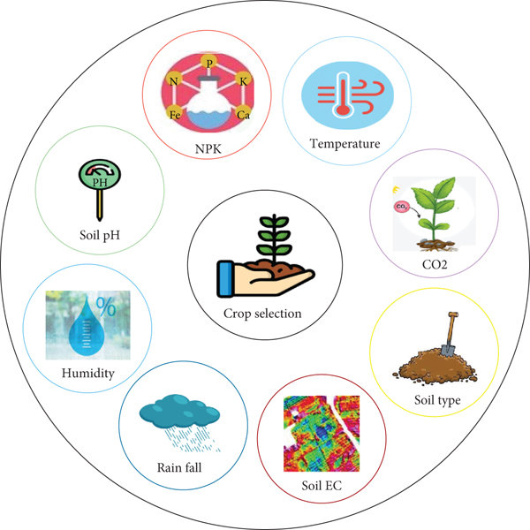
EXISTING SYSTEM
An existing multi-criteria agriculture recommendation system typically employs machine learning techniques to predict suitable crops and optimal fertilizer recommendations based on various factors.
These factors often include soil quality, climate data, historical crop yields, and nutrient content analysis.
Machine learning algorithms such as decision trees, random forests, support vector machines, or neural networks are commonly used to analyze and process large datasets to generate recommendations.

Slide 6
PROPOSED METHOD
Proposed model predict crop based on rainfall, temperature, humidity and soil moisture.
Dataset is pre-processed and converted to numerals before training and prediction
There are three techniques applied for prediction.
SVM and logistics regression is used.

Slide 7
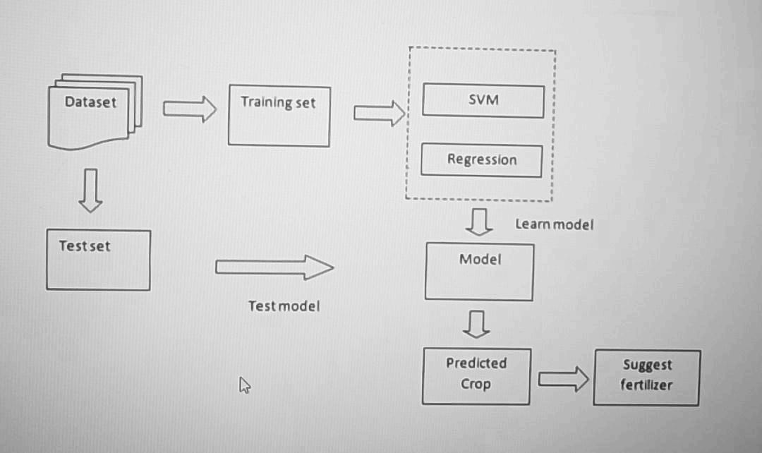
ARCHITECTURE DIAGRAM

Slide 8
REQUIREMENTS
Hardware Requirements :-
Processor :Any Processor above 500 MHz.
Ram :4 GB
Hard Disk :4 GB
Input device :Standard Keyboard and Mouse
Output device Monitor :VGA and High Resolution
Software Requirements :-
Operating System :Windows 7 or higher
Programming :Python 3.6 and related libraries

Slide 9
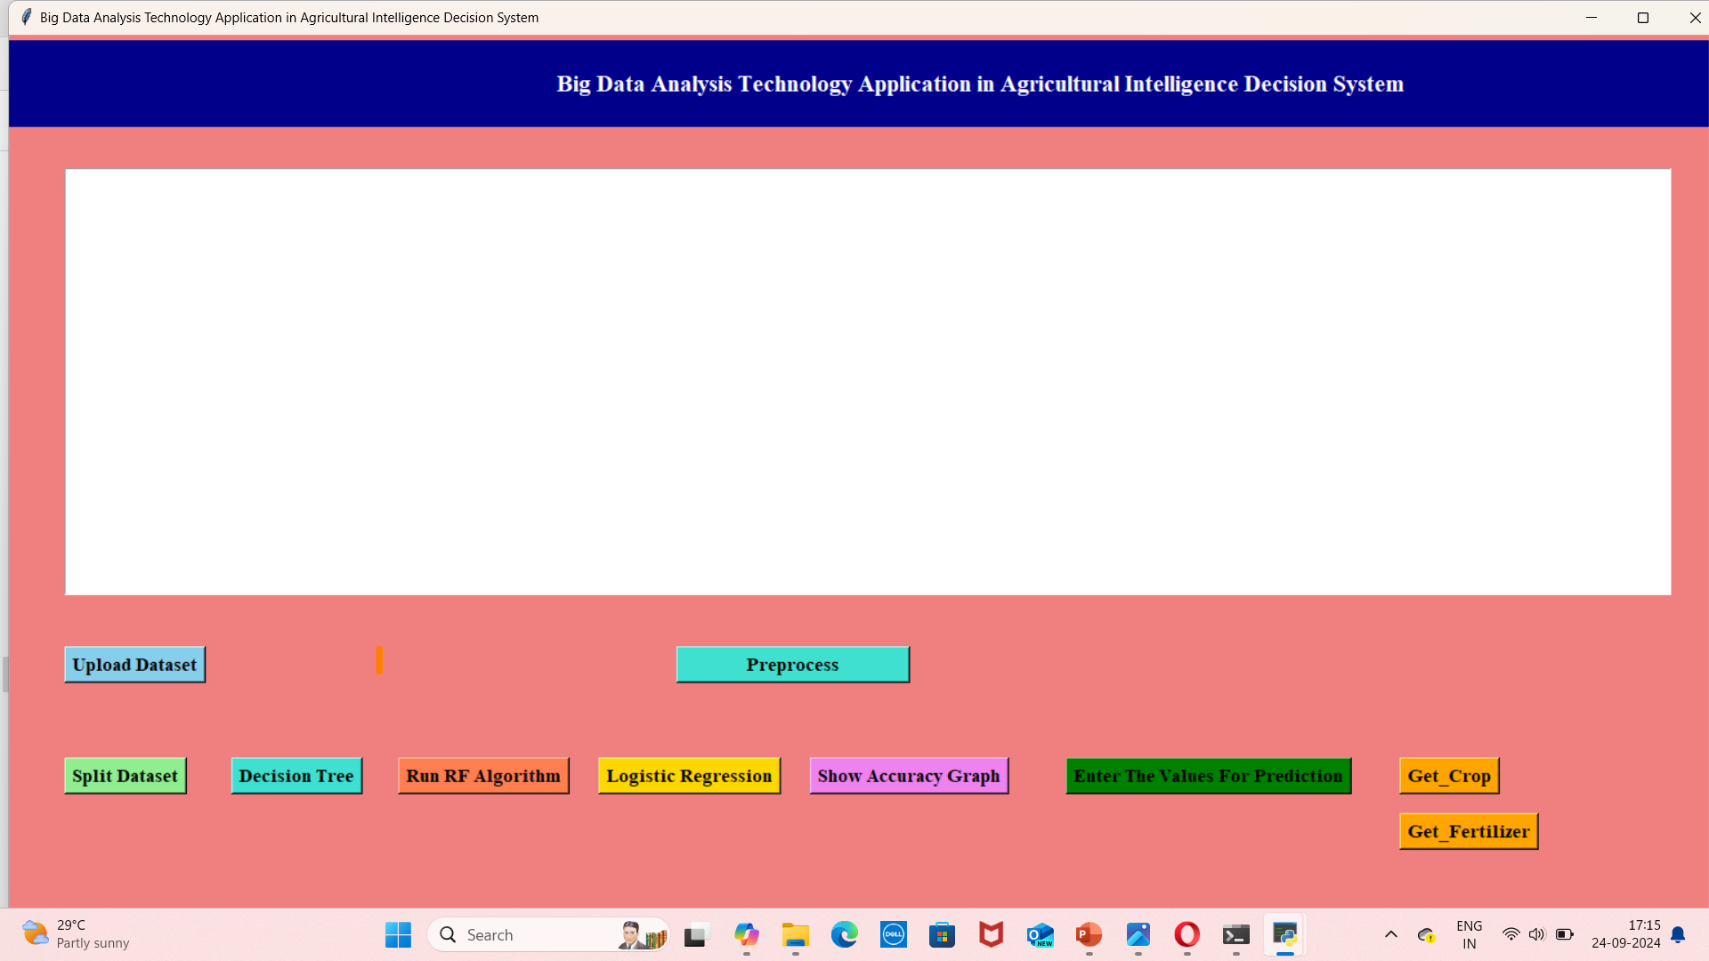
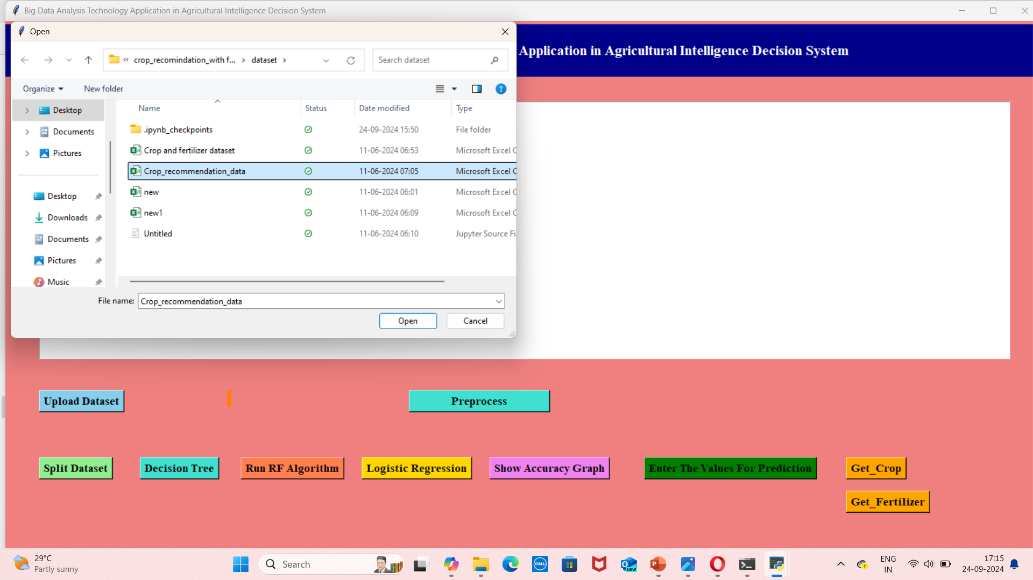
Result Analysis : HTML PAGE: Upload dataset:

Slide 10
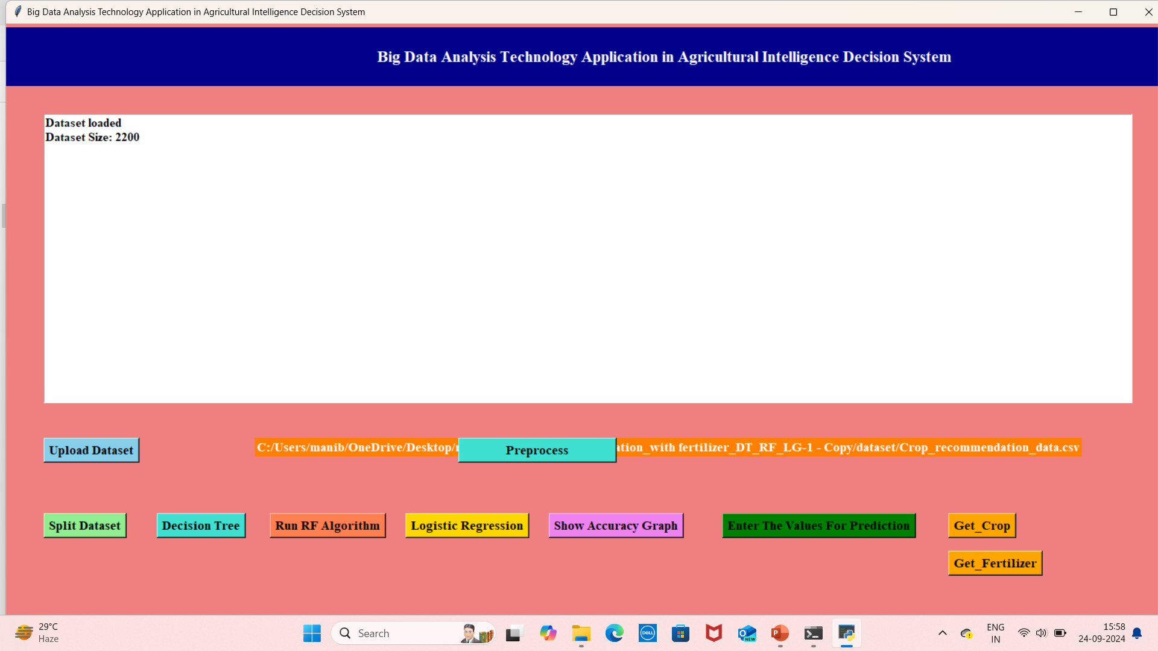
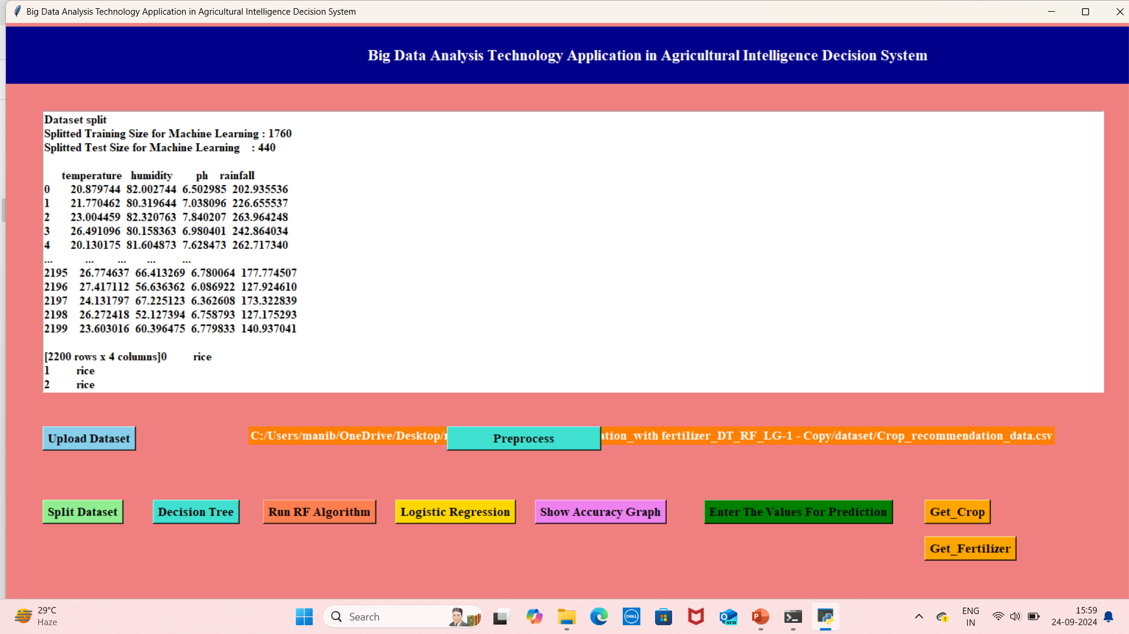
Split dataset: After splitting dataset:

Slide 11
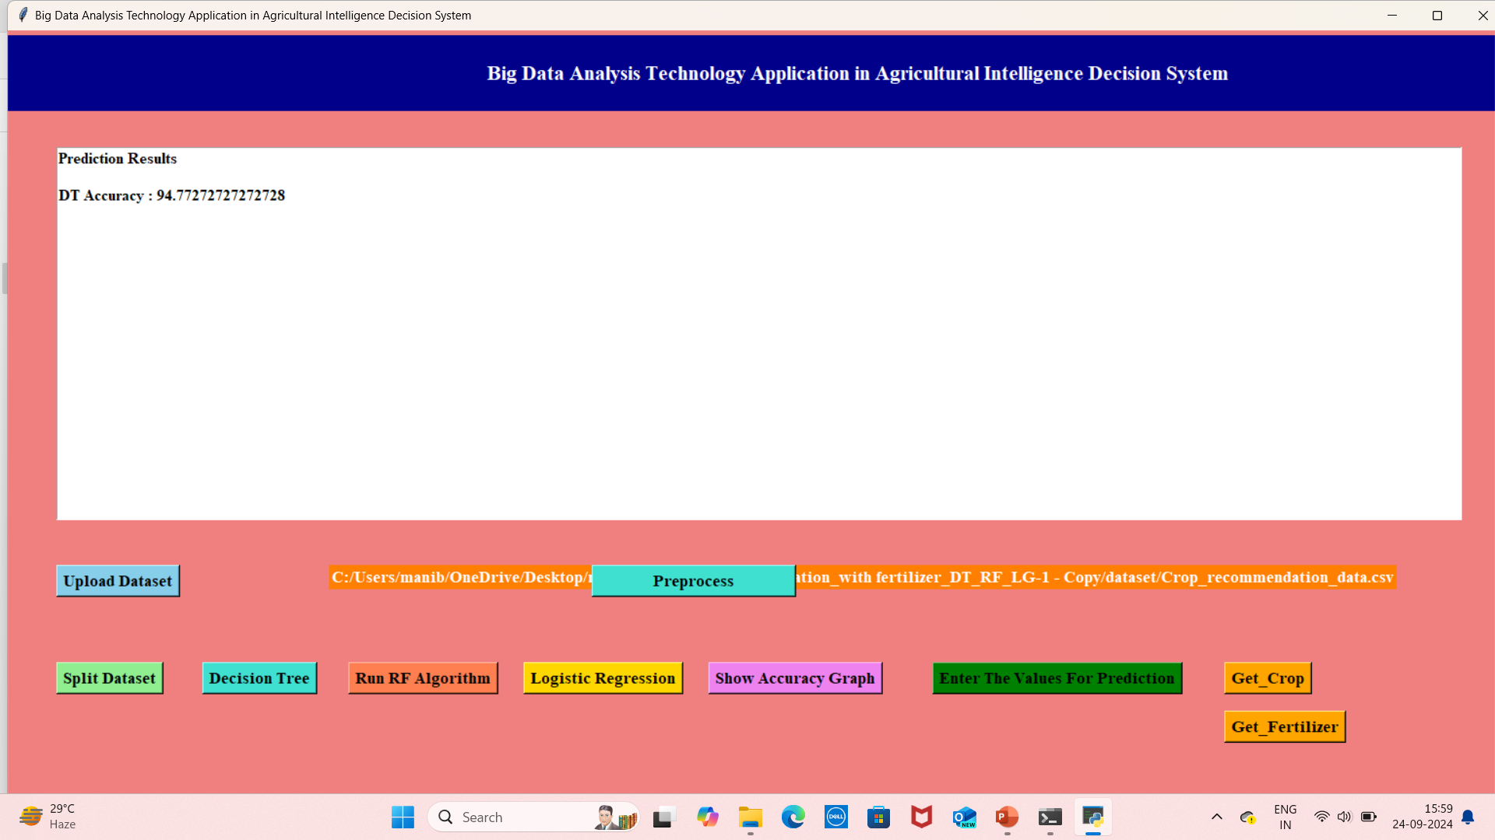
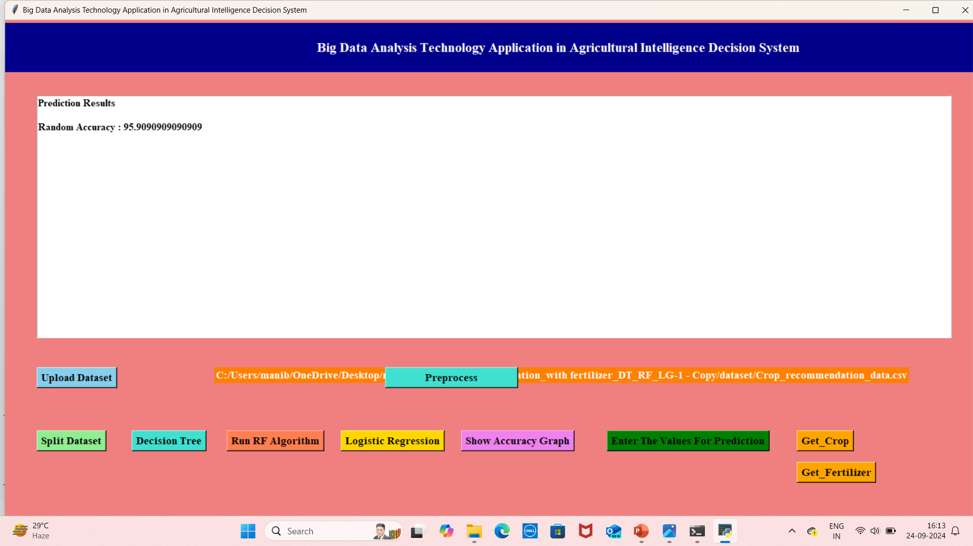
RUN_SVM: Run RF Algorithm:

Slide 12

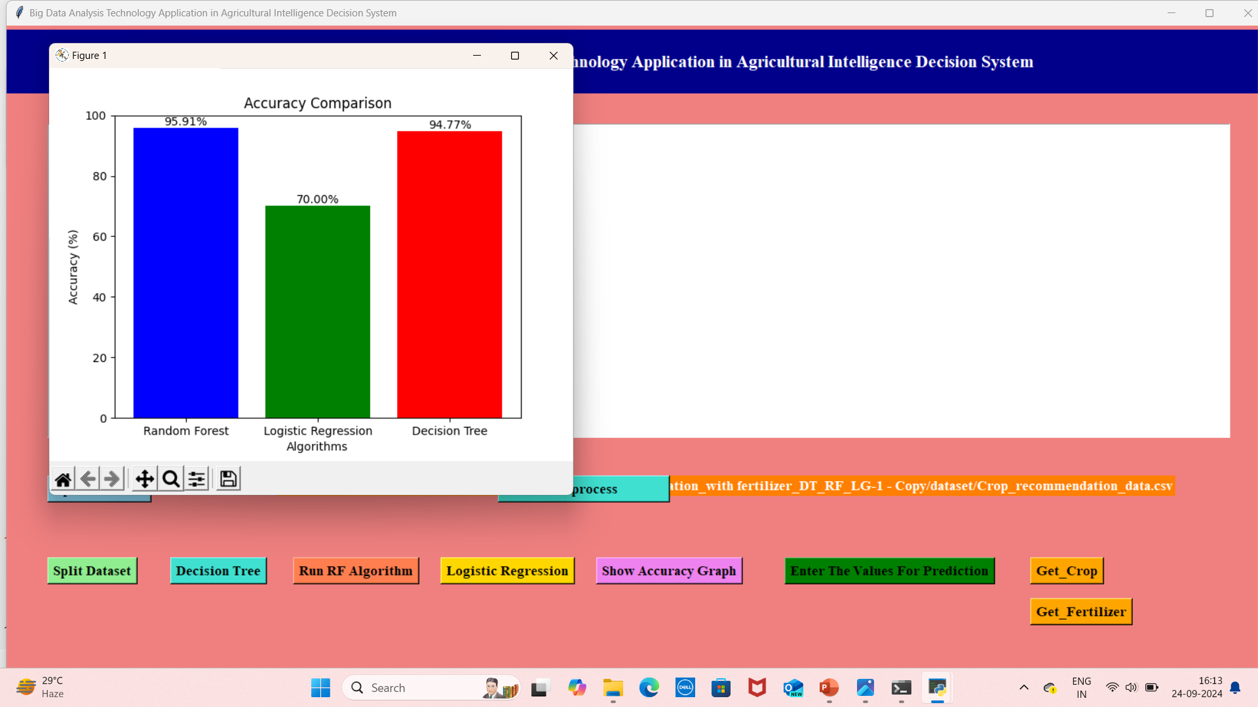
Logistic Algorithm: Accuracy Graph:

Slide 13
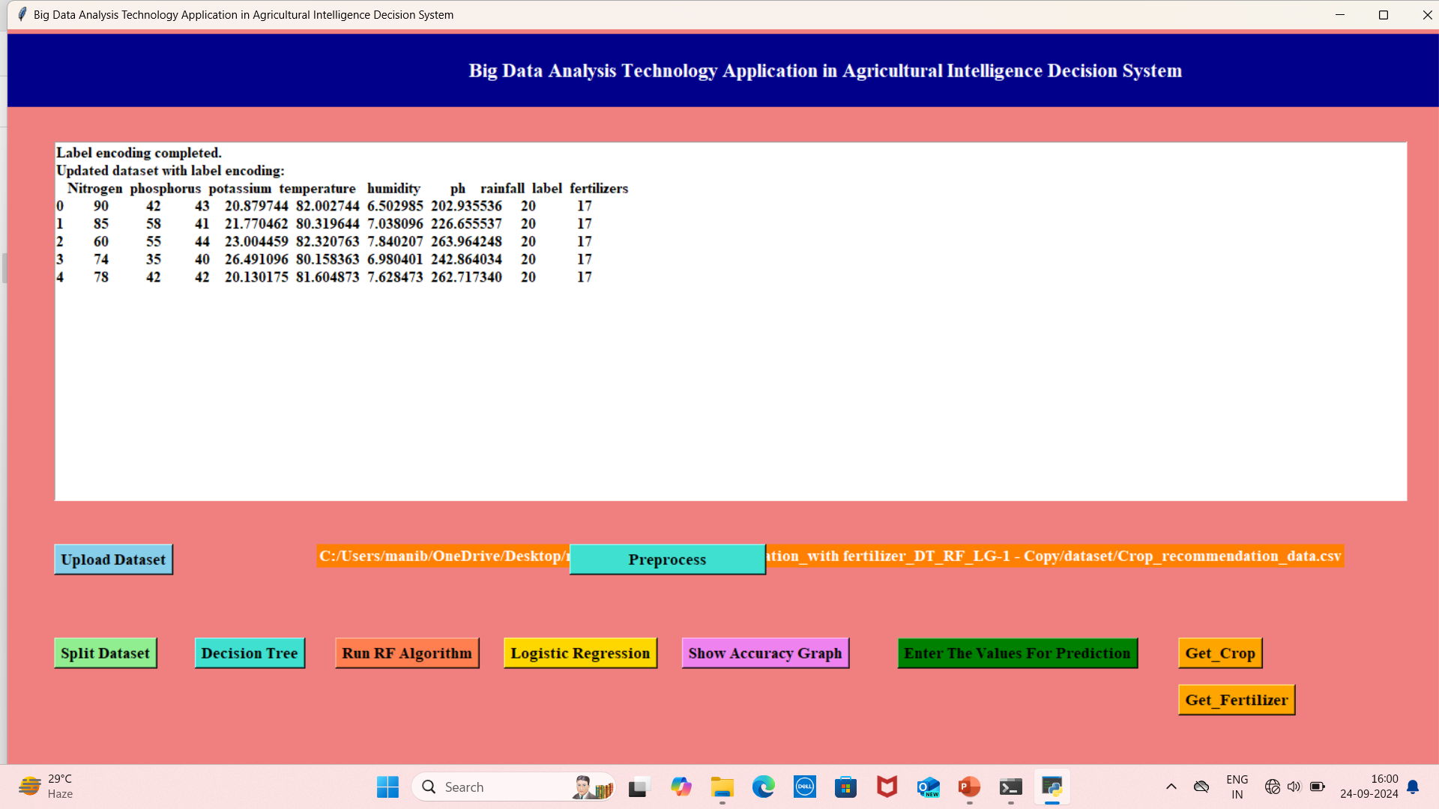
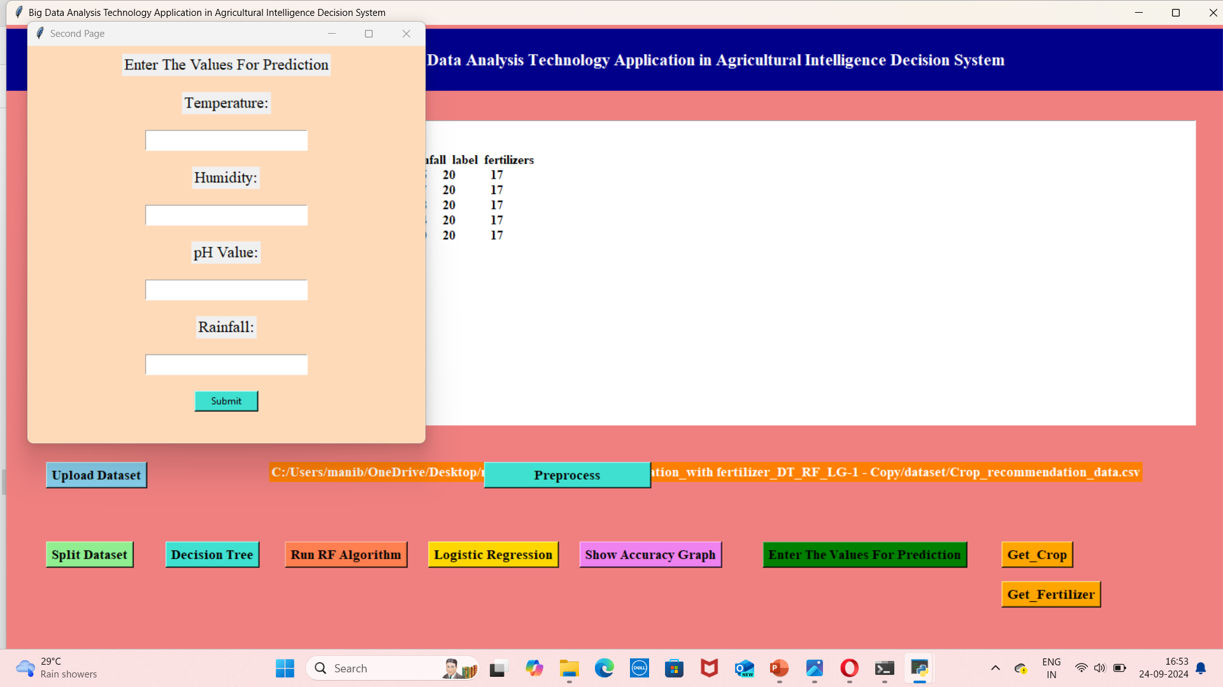
Preprocess: Before entering the values:

Slide 14
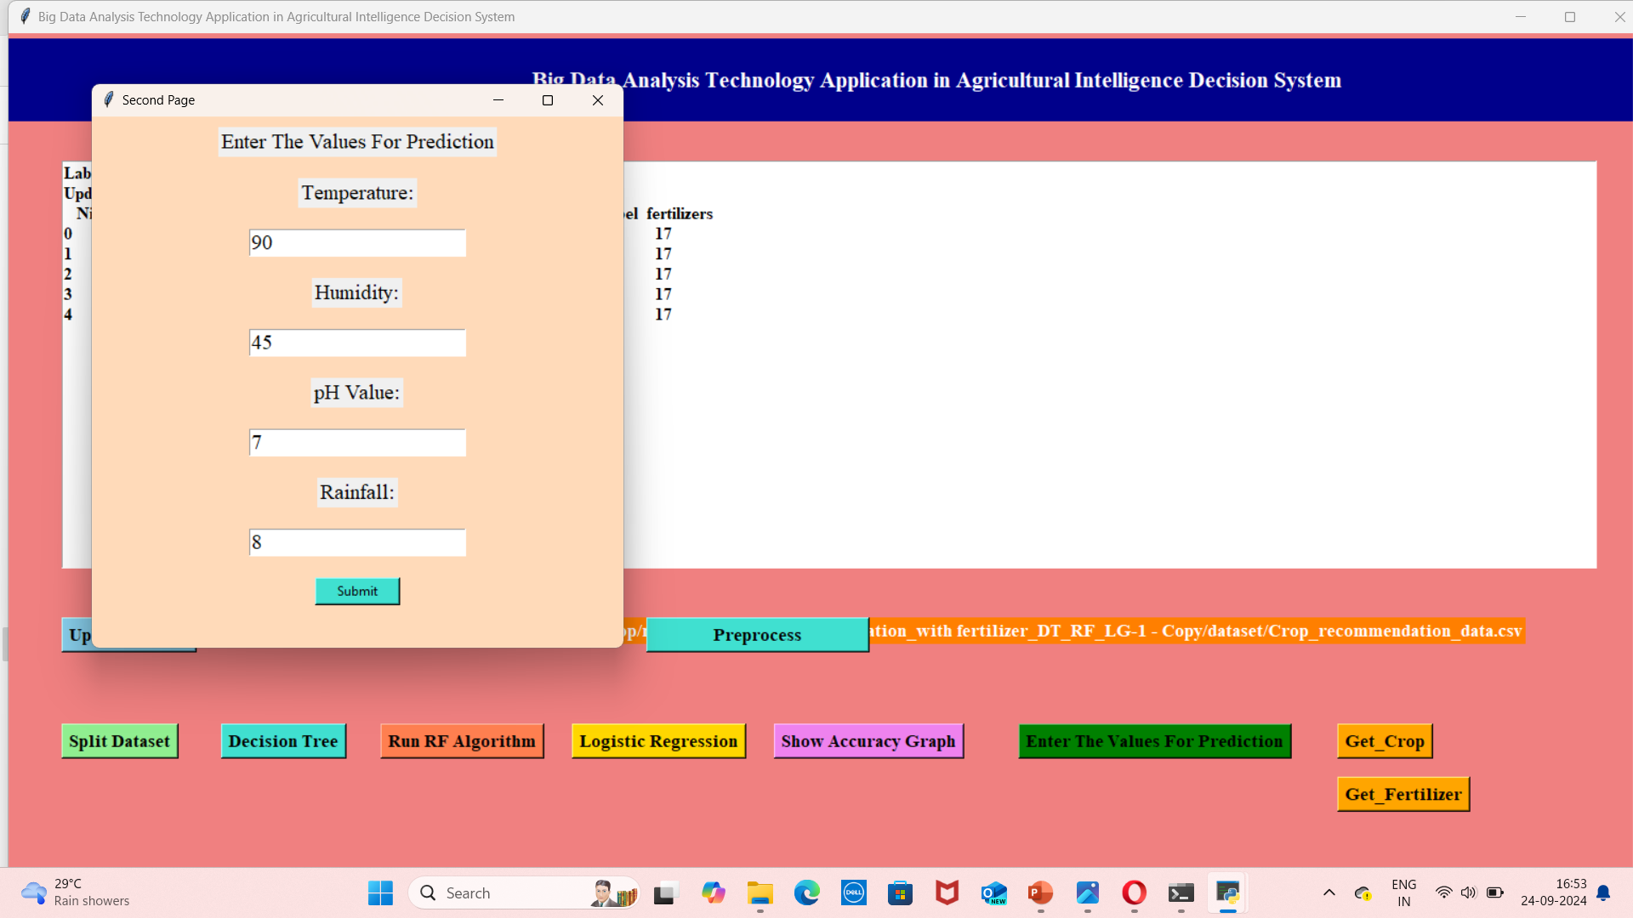
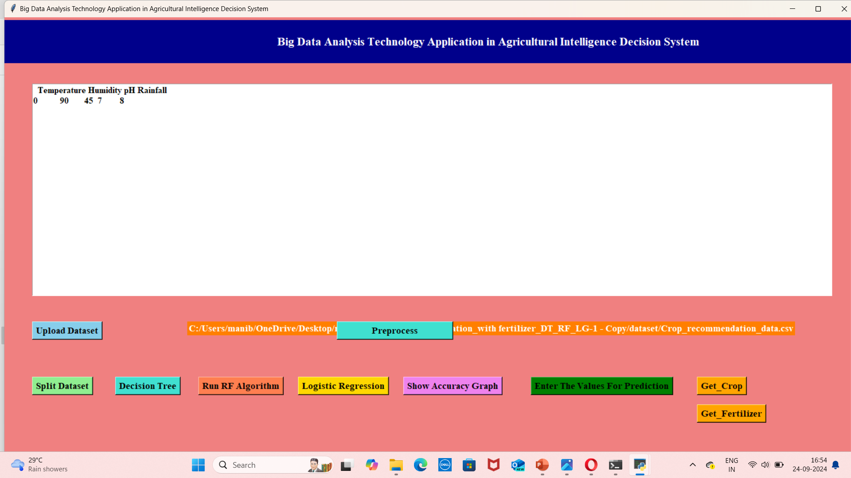
Enter the values: After entering the values:

Slide 15
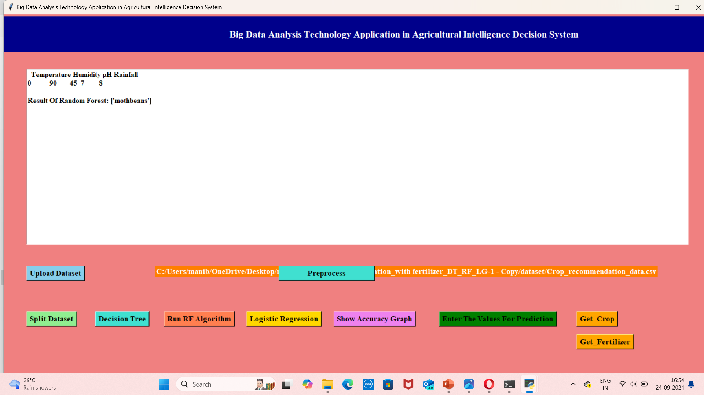

Prediction of crop: Final output:

Slide 16
ADVANTAGES
Give good accuracy for the considered dataset
Crop prediction accuracy helps farmers to get better cultivation and yield by using this technique.
Fertilizer is suggested.

Slide 17
APPLICATIONS:
Crop Selection : Algorithms analyze soil type, climate conditions, and historical data to recommend the most suitable crops for a specific region.
Yield Prediction : Machine learning models predict crop yields based on various factors, including weather patterns, soil health, and farming practices.
Fertilizer Recommendation : Systems provide tailored fertilizer suggestions based on soil nutrient levels, crop requirements, and growth stages to optimize plant health and yield.
Pest and Disease Management : Predictive analytics can identify potential pest infestations or diseases, allowing for timely interventions and recommendations for crop protection measures.

Slide 18
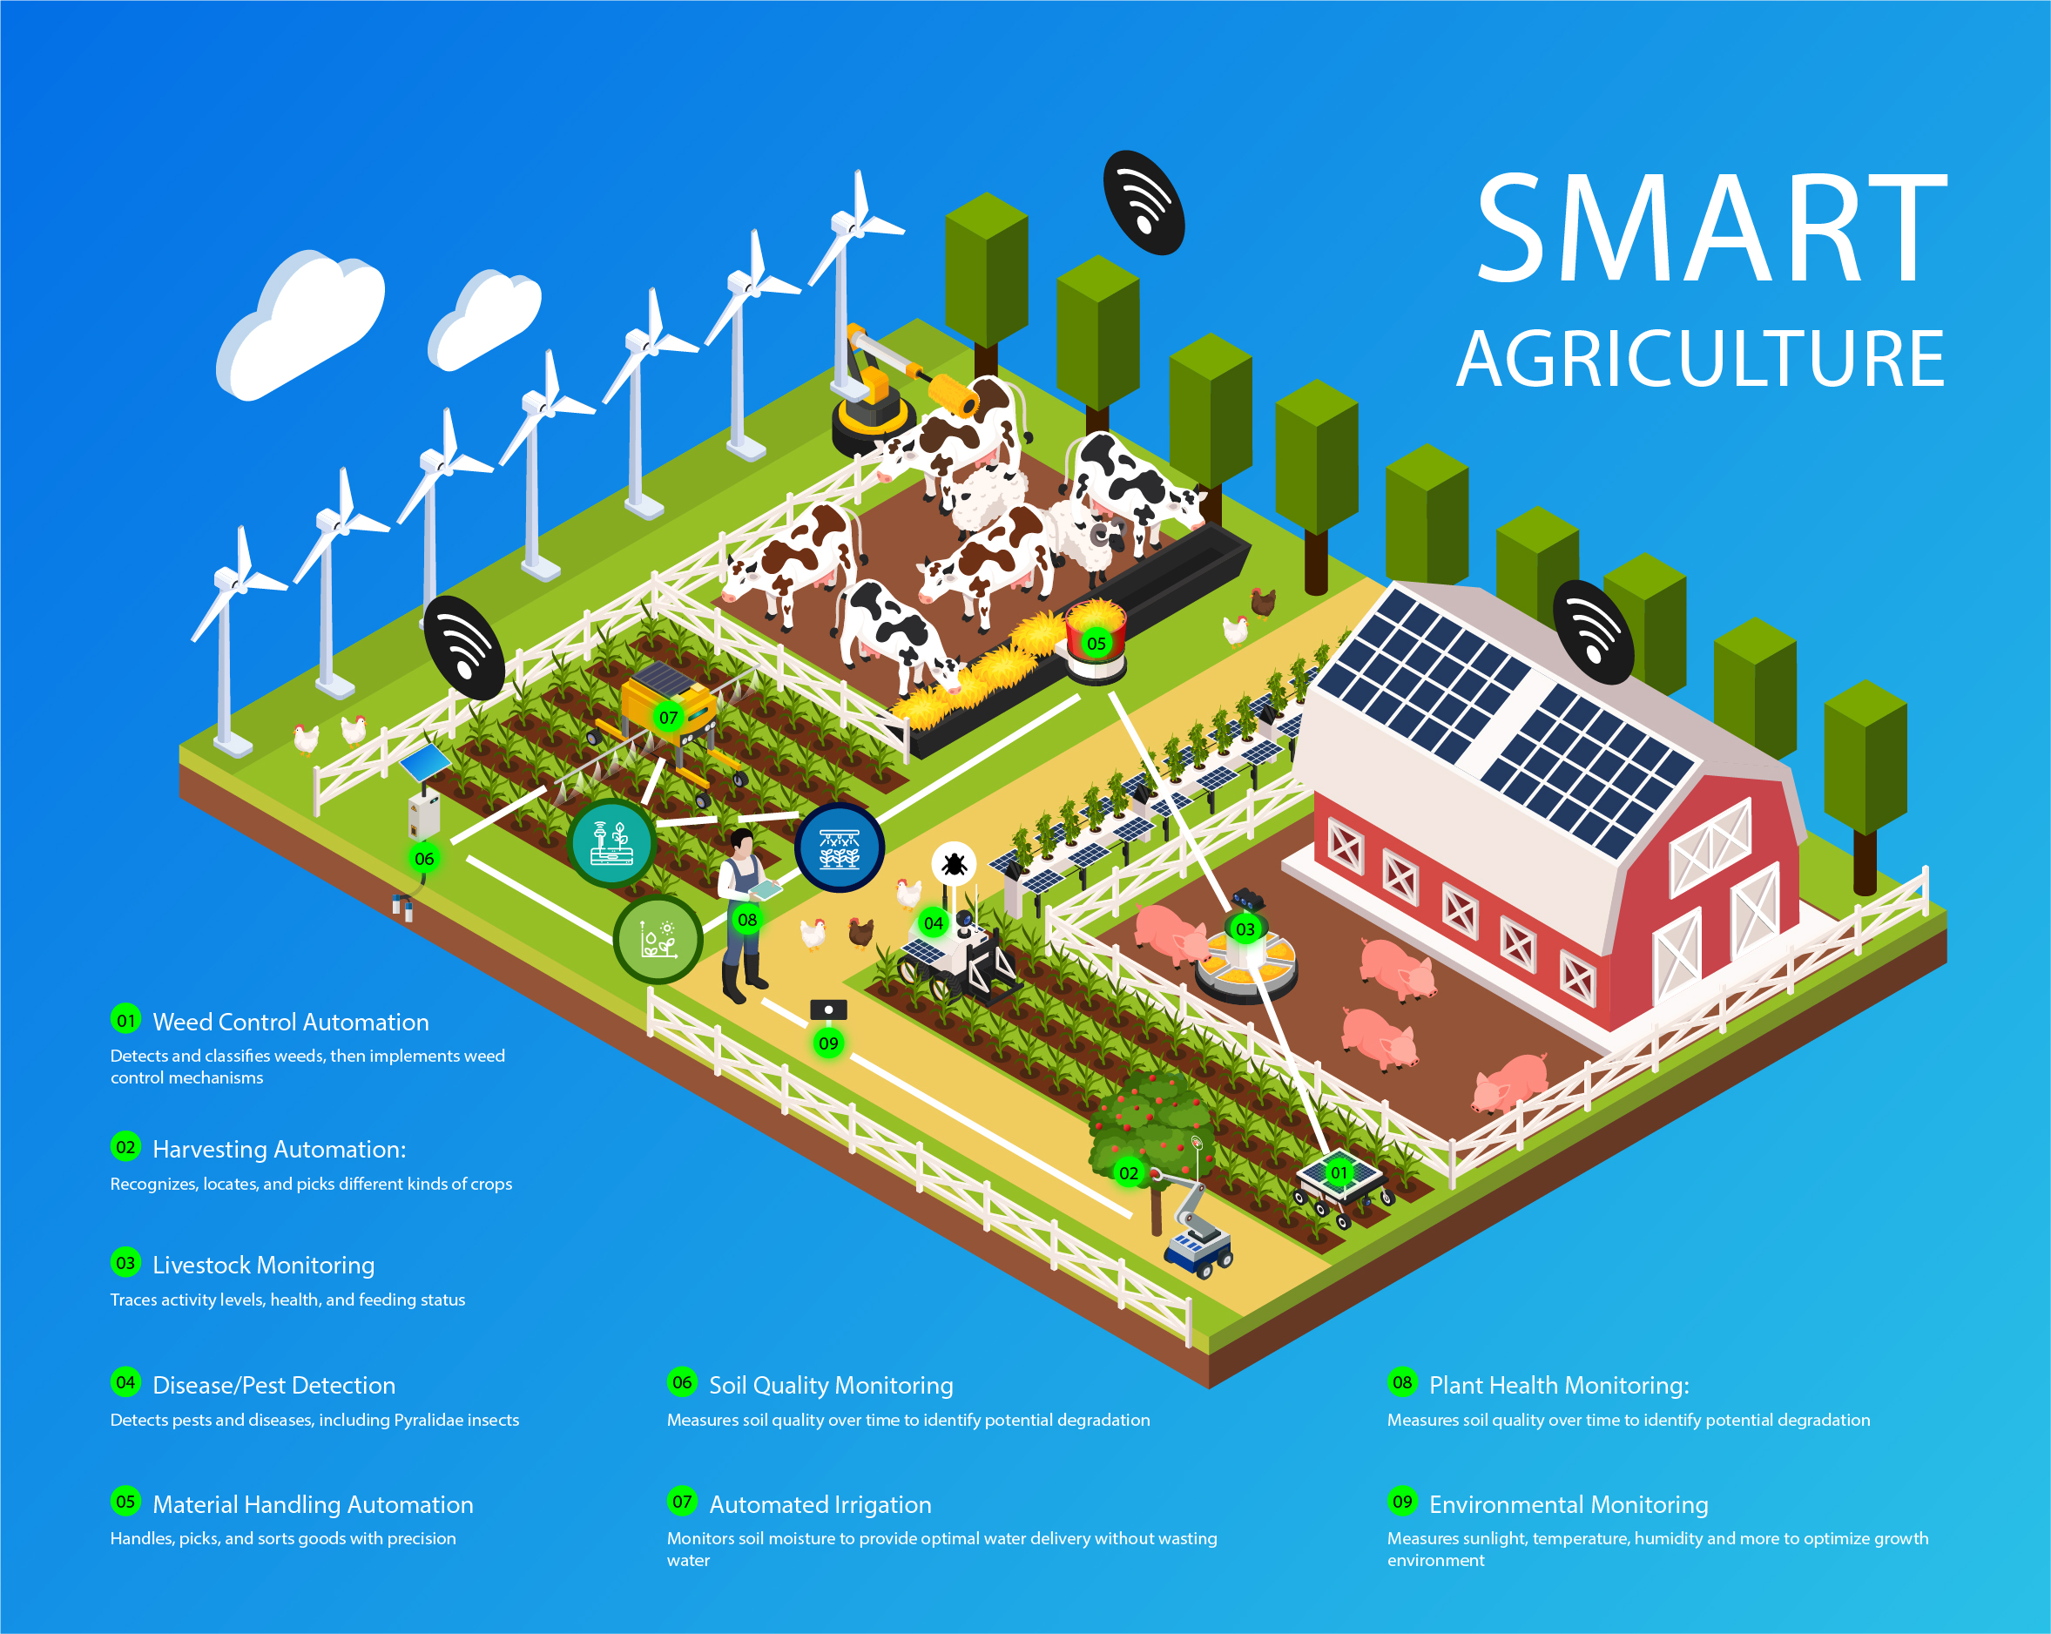
CONCLUSION
Machine learning can be used to create agricultural recommendation systems that help farmers choose crops and fertilizers for their soil.
These systems can help farmers increase crop yields and maximize profits by considering factors like rainfall, temperature, and soil nutrients.
As technology advances and more data becomes available, these systems will continue to evolve, further supporting the goal of efficient and sustainable agricultural practices.

Slide 19
Future Scope
Some future work could include identifying diseases in recommended crops and suggesting pest control techniques.
Future Work on this can add many options such as:
Diagnosis and prevention of plant diseases, predicting plant species.
Current Market Conditions and analysis for information on crop.
The mobile app can be developed to assist farmers with uploading farm photos.
Continuous advancements in technology and data analytics will further refine these applications, leading to smarter agricultural practices.

Slide 20
REFERENCES
"Machine Learning in Agriculture" by S. K. Gupta and R. S. Awasthi. This book covers various applications of machine learning in agriculture, including crop prediction and fertilizer man.
Online Courses : Platforms like Coursera or edX offer courses on machine learning applications in agriculture, which often include case studies and practical examples.
Datasets: Kaggle has several datasets related to agriculture that can be used to develop and test models for crop and fertilizer prediction.

Slide 21


